Slide 1
Netflix Recommendation Engine
Group 9
Tim Schaefer, Won Joon Choi,
Aparajita Kar, Sumukh Nitundila
December 16, 2021

Slide 2
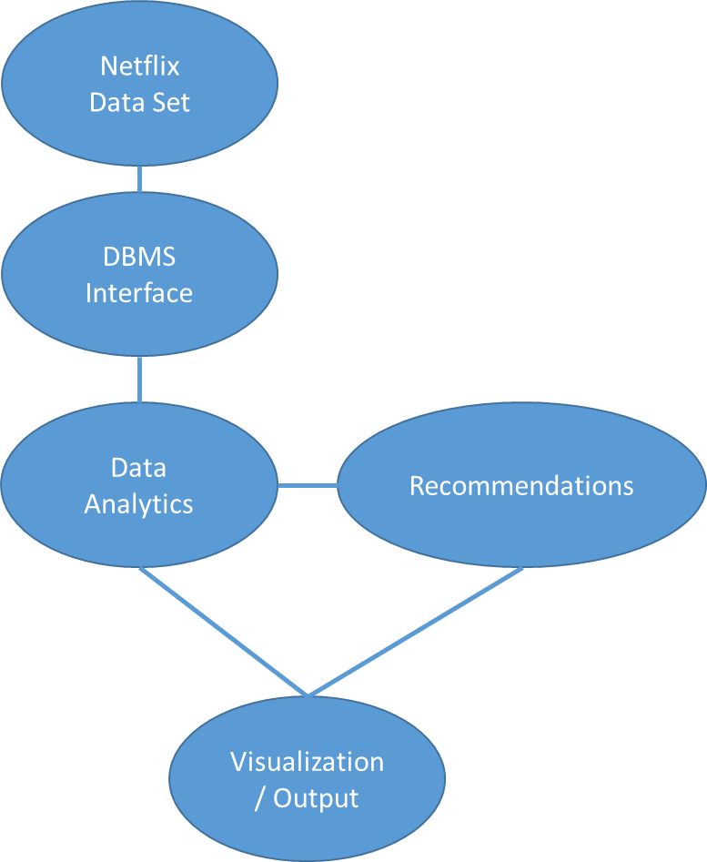
Objective
Develop Research focused DBMS and Data Analytics Netflix Recommendation System
Netflix
Data Set
DBMS Interface
Data
Analytics
(Preprocessing)
Recommendation Engines
Recommendation Output
User Modes
Initial Show Selection (Genre, Ratings, etc)
Secondary Show Selection (Based on Initial Show)
Historical Show Selection (Based on Historical Shows)
Notes:
Tim

Slide 3
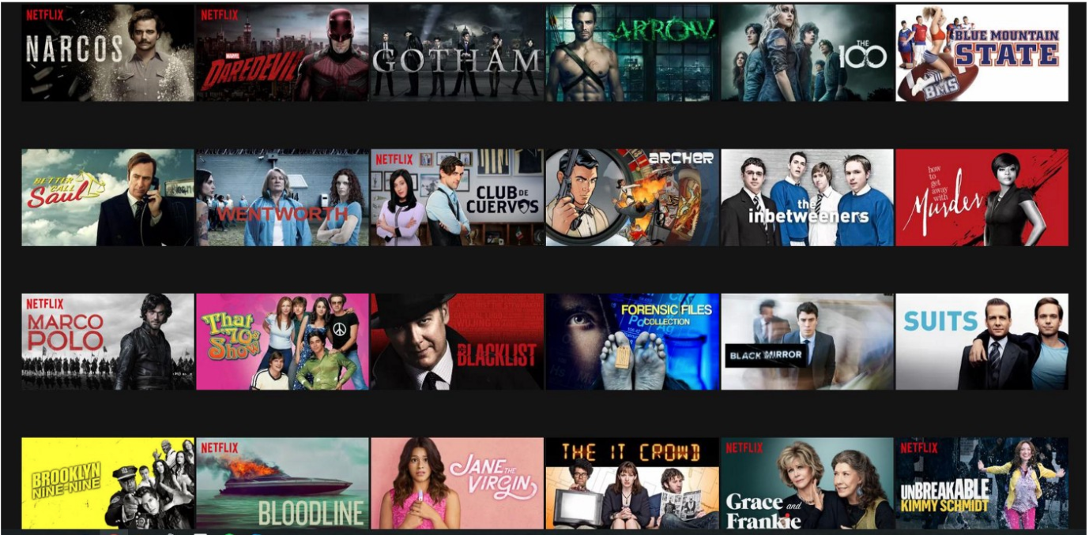
Approach
Obtain dataset from Kaggle
https://www.kaggle.com/syedmubarak/netflix-dataset-latest-2021
Develop a DBMS system to support queries from the data analytics to develop show recommendations
Utilized Python for Data Exploration and Data Visualization
Utilized Python for creating different recommendation systems to suggest top movies to a user
Notes:
Tim

Slide 4
Data Description / Cleaning
Consolidation of Ratings
Ex. “Not Rated”, “NOT RATED”, Empty =>“Unrated”
Ex. “TV-13”, “TV-14”, “PG-13” => “PG-13”
Conversion to Numeric Representation
“G”” => 0
“PG” => 1
“PG-13” => 2
“R” => 3
“NC-17” => 4
“Unrated” => 10
Punctuations removed
Removal of stop words
Dictionaries Mapped / Searchable / Multi-Field Parsing
Title
Country Availability
Languages
Genre
Tags
Gem Rating
IMDb Rating
Ratings
Release Date / Year
9425 entries
29 attributes
Features include information about the type of movie:
Genre: Comedy/ Romantic/ Drama/ Action/ Thriller
Director/Actors/Writer
Summary of the movie
Rating: TV-18, PG-13
IMDb rating, Metacritic Score, Rotten Tomatoes Score,
Country, Languages, Release Date
Other features
*Genre, Language, Country Availability, Tags, IMDb ratings, View Ratings, Summary are primarily used for the purpose of building the recommendation system
Notes:
Aparajita
There are 9425 records present in the dataset which have 29 total attributes. These attributes are:
genre like comedy, romantic, drama, action
It has information about the director, actor, writer
Summary of the movie
Maturity like rating like TV-18,
IMDb rating and other scores
country, language, and release date of the movie
Other features like runtime availability, IMDb votes etc.
In terms of data cleaning,
There are some inconsistencies present in the data like not rated, unrated, NOT RATED which means the same, all these values are corrected and transformed to Unrated.
All similar maturity ratings are converted to a single value like the one in this example
All these maturity ratings are converted to numeric values which could be encoded in the model
Punctuations are removed since for processing of the data
All stop words which appear frequently and do not add any valuable information are removed
A dictionary mapping is created for each feature to be able to use in the recommendation system.

Slide 5
Content Based Filtering
Collaborative Filtering
Suggest similar items based on a particular item (or items) given by a user (in this case a movie title, language, genre, country, release date)
Compute pairwise cosine similarity scores for all movies based on the user descriptions and recommend movies that are most similar.
Create a bag of words for all movies
Tf-Idf encoding
Create a cosine similarity matrix
Suggests movies based on how similar a user profile is to other users’ profile
If there is a new movie in Netflix that no-one else had yet liked or watched it, it is not going to be in the list of recommended movies, even if a user likes it
Based on attributes related to a user profile Ex: ratings provided by a user to multiple movies.
Notes:
Aparajita
One of the very popular recommendation systems is Content-Based Filtering and Collaborative Filtering. In content-based filtering, user interests are compared to the product features, and recommendations are made based on the similarity score between them. In this case, we first filtered the dataset based on the user input like the genre, IMDb rating, language, country availability, and then created a bag of words that contains the vector representation of these features including the summary of the movie that the user had liked. A cosine similarity matrix is then created based on the term frequency/ inverse document frequency of the feature vector. The result is the top 10 recommended list of movies.
The second most popular recommendation system is collaborative filtering which suggests movies based on a different user whose taste may be similar to you. It requires the user demographic and ratings provided to multiple movies by different users. Since our dataset does not have any information regarding the users ratings, we decided not to implement this recommendation system. However, Netflix uses both content as well as to provide suggestions to its users.

Slide 6
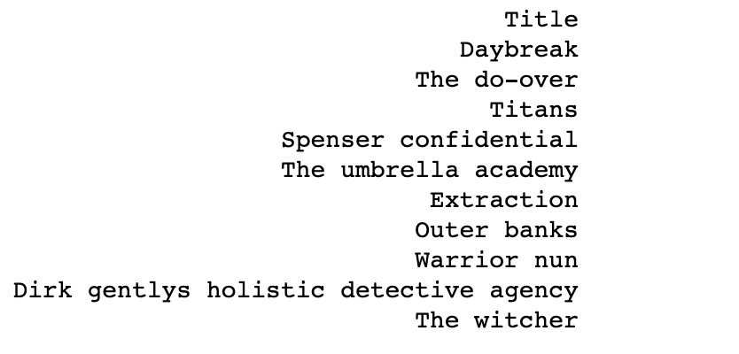
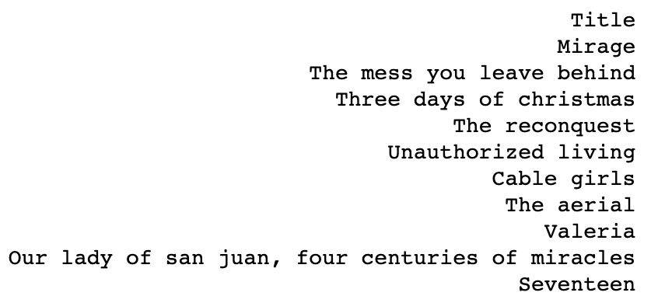
Result : Content Based Filtering
Input → Genre (Action), Country Availability (India), IMDb Score (5 and above), Language(English), Title (“Red”), Release Year = 2006 and beyond
Input → Genre (Drama), Country Availability (Spain), IMDb Score (5 and above), Language(Spanish), Title (“The Barrier”), Year = 2006 and beyond
Features → Genre, Country Availability (since movies are present in multiple languages), Summary, Languages, Tags, View Rating, Actor
Notes:
Aparajita
Here we can see, the results of the top 10 recommended movies after giving the following input by two users.

Slide 7
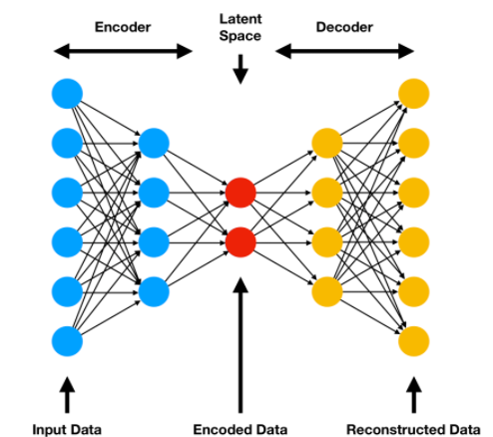
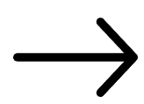
K-Nearest neighbors approach using
reduced dimension
Features used
Genre, Languages, Country Availability, IMDb Score
One-hot encode categorical features
5 361 columns
Dimension reduction using encoded layer of autoencoder
2 layers for encoded layer, 2 layers for decoded layer
KNN to find 10 closest movies
Credit: Comp Three Inc
Notes:
Won
Features used - Genre, languages, country availability, IMDb score
One-hot encoding of the categorical features -> Genre, languages, country availability
Dimension reduction using autoencoder
FInally, used KNN to find 10 closest points using Minkowski distance metric

Slide 8
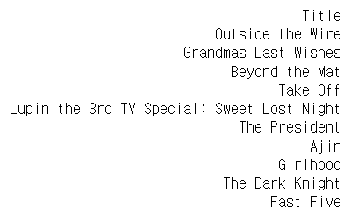
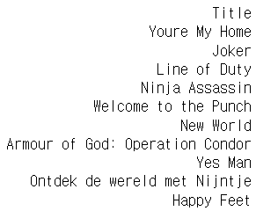
Result: KNN
Notes:
Won

Slide 9
Modified Content Based Recommender
How can we improve the previously mentioned content based system?
Impute missing values of movie summary with movie title, tags with genre and language as english.
Use porter stemmer to “stem” words in the description and merge all the columns into one.
Merge attributes, Calculate Tf-Idf, cosine distances and the nearest 10 entries are recommended
Notes:
Sumukh

Slide 10
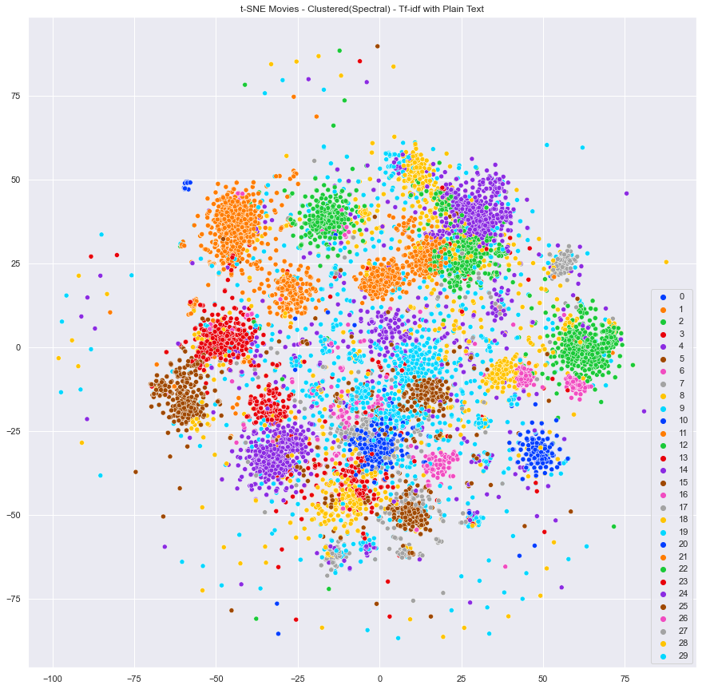
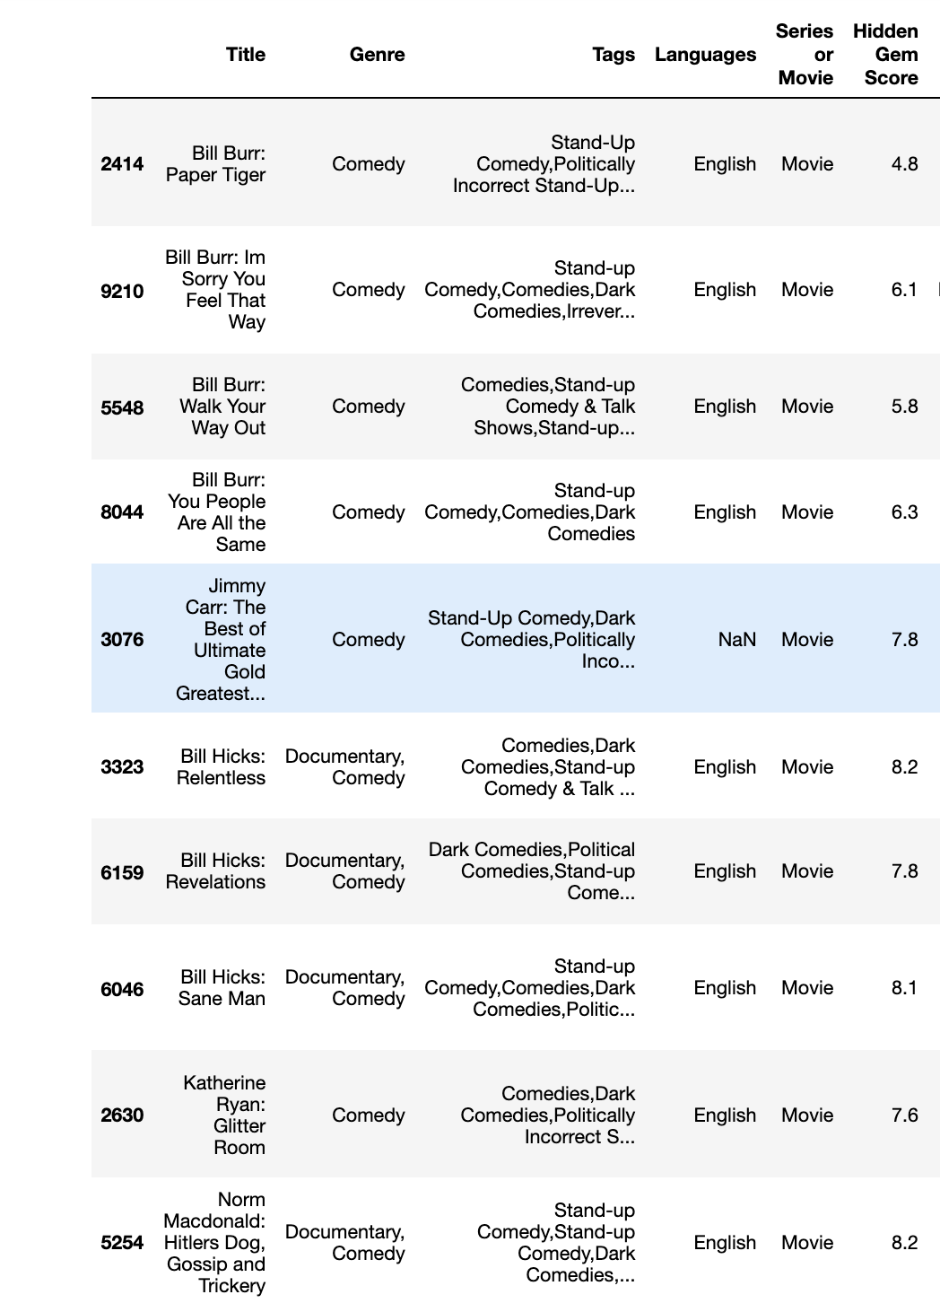
Results
Notes:
Sumukh
How to find out which features to pick?

Slide 11
Decision Tree Implementation
1st Approach - Recommendation based on Historical X- Number of Views
Assumption - Country Availability
Choose most prevalent features (language, genre, tags)
Numeric Scores (IMDB, Hidden Gem, Release Year, Rating)
Criteria Tolerances for Numerics (ex. Ratings can choose shows +/- 1 Rating Level)
“PG” => “G”, “PG” or “R” (Parental-Like control “NC-17” or “X” Rating to a “G” User)
2008 => 2006 - 2010
IMDB and GEM => Average Value +/- 2 rating points
2nd Approach - Recommendation based on User Criteria
User Steps Through Recommendation Layers / Filters
Country => Language => Genre => Tags => Minimum IMDB Rating => Minimum Gem Rating => Rating => Release Year
Auto trimming tree
Automatically Go Up one Feature Layer if No Shows Meet the Criteria
Integrated with a Simple GUI
Notes:
Tim

Slide 12
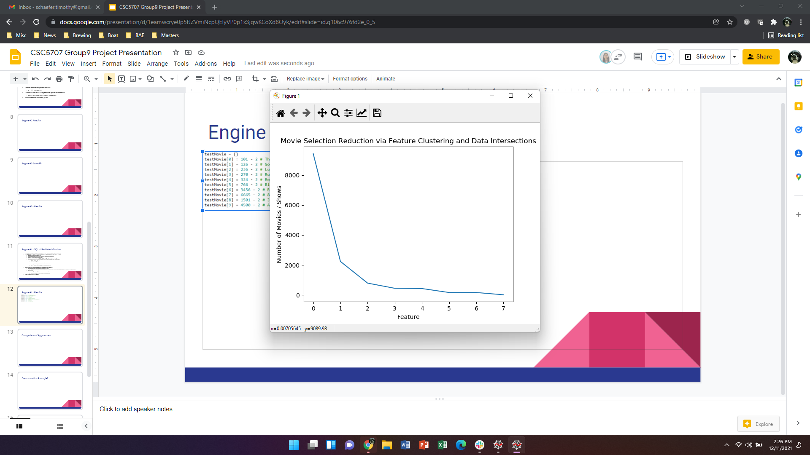
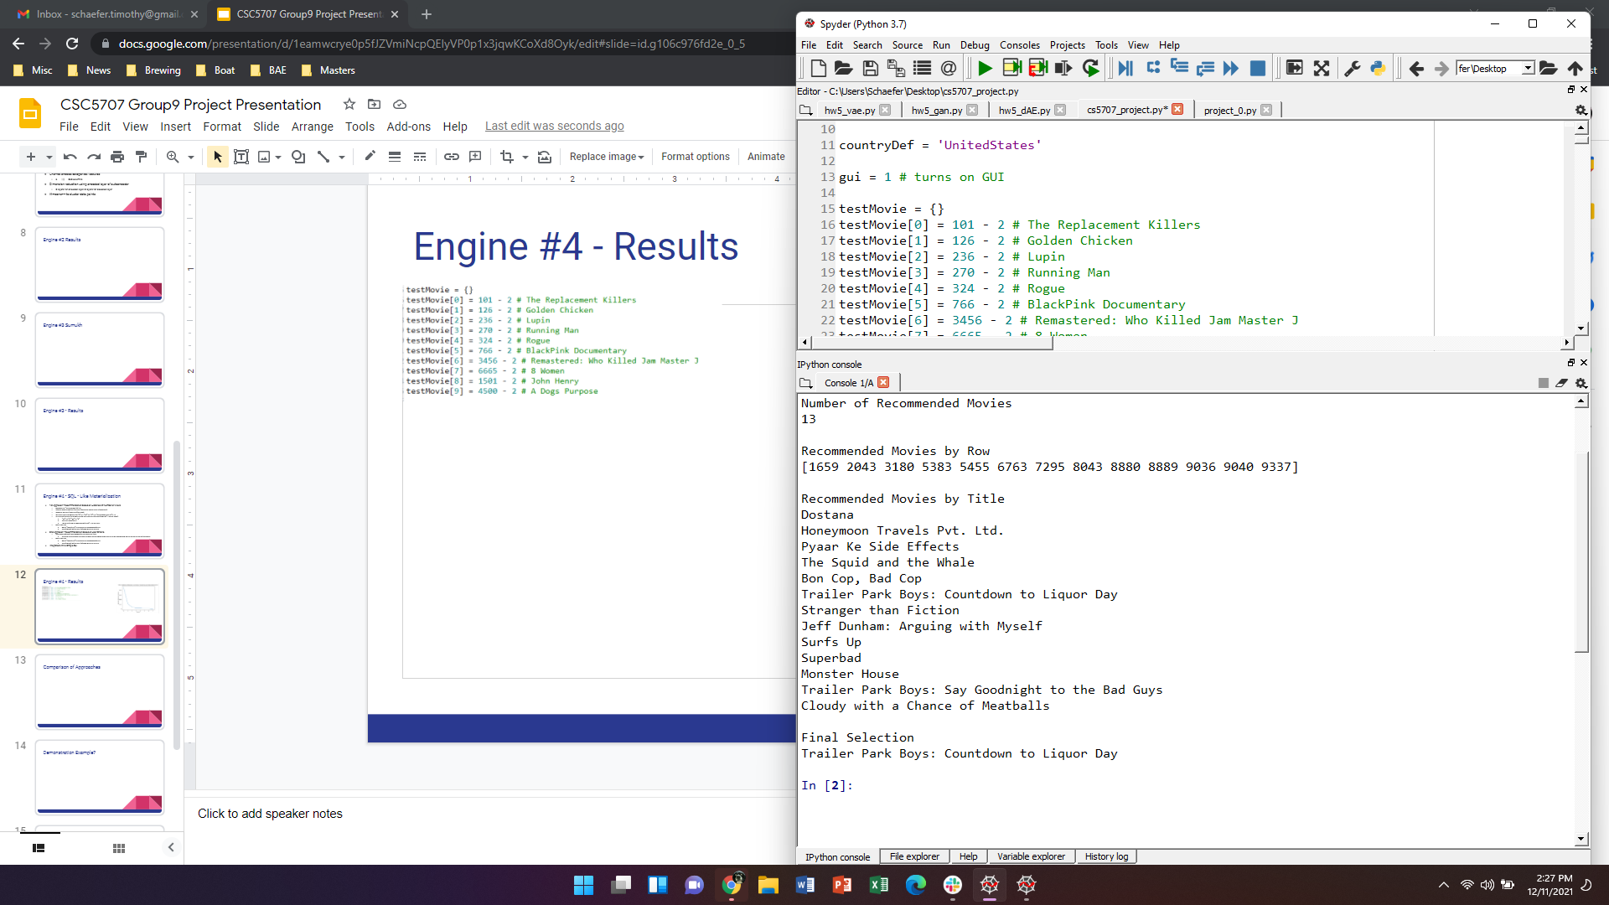
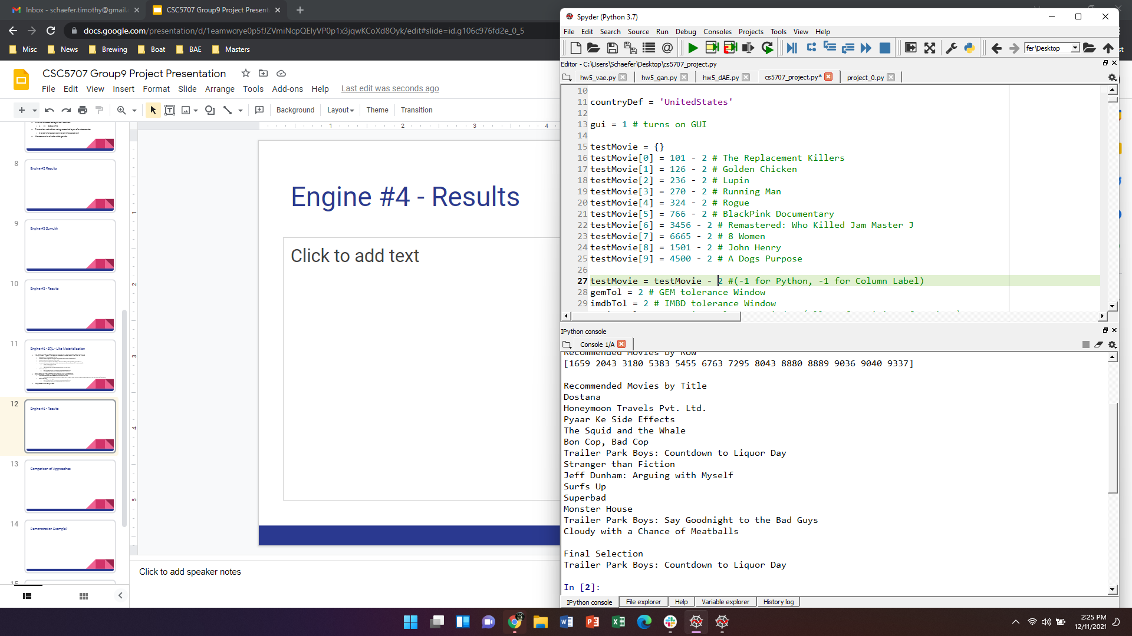
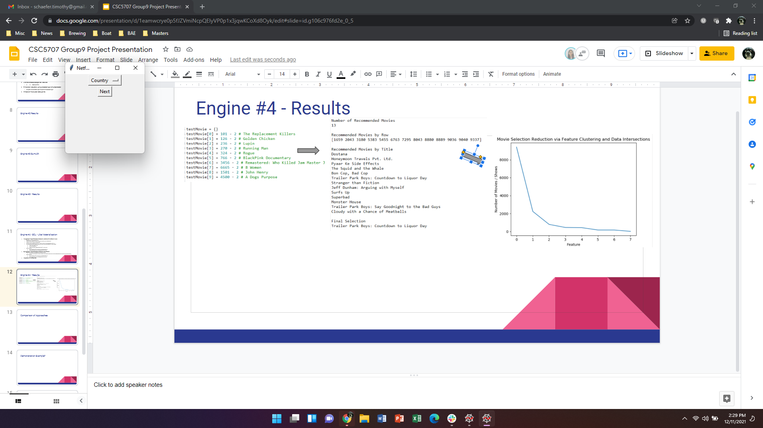
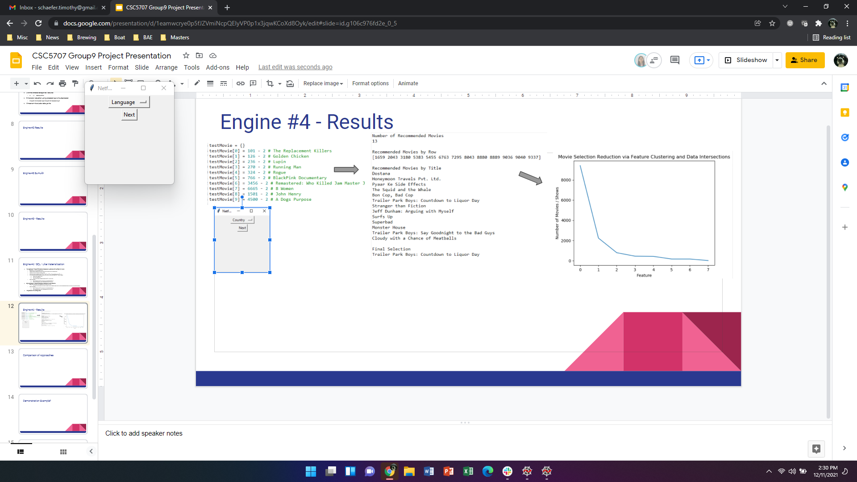
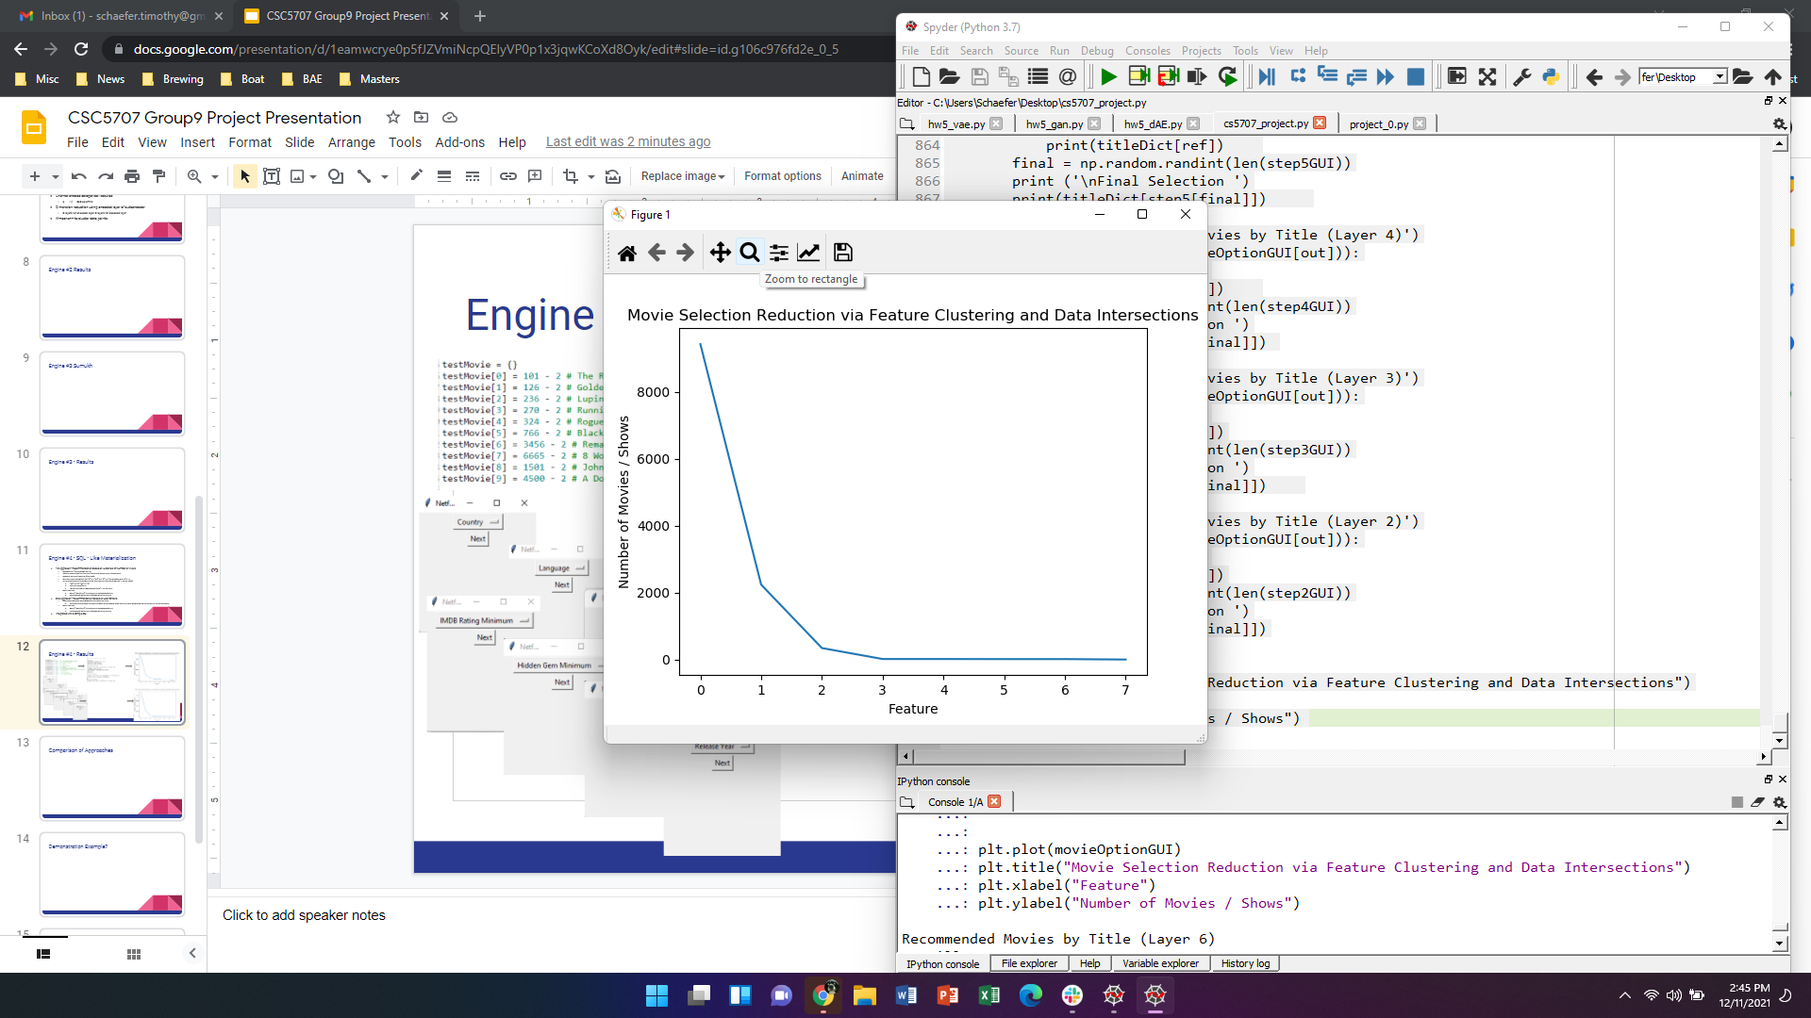
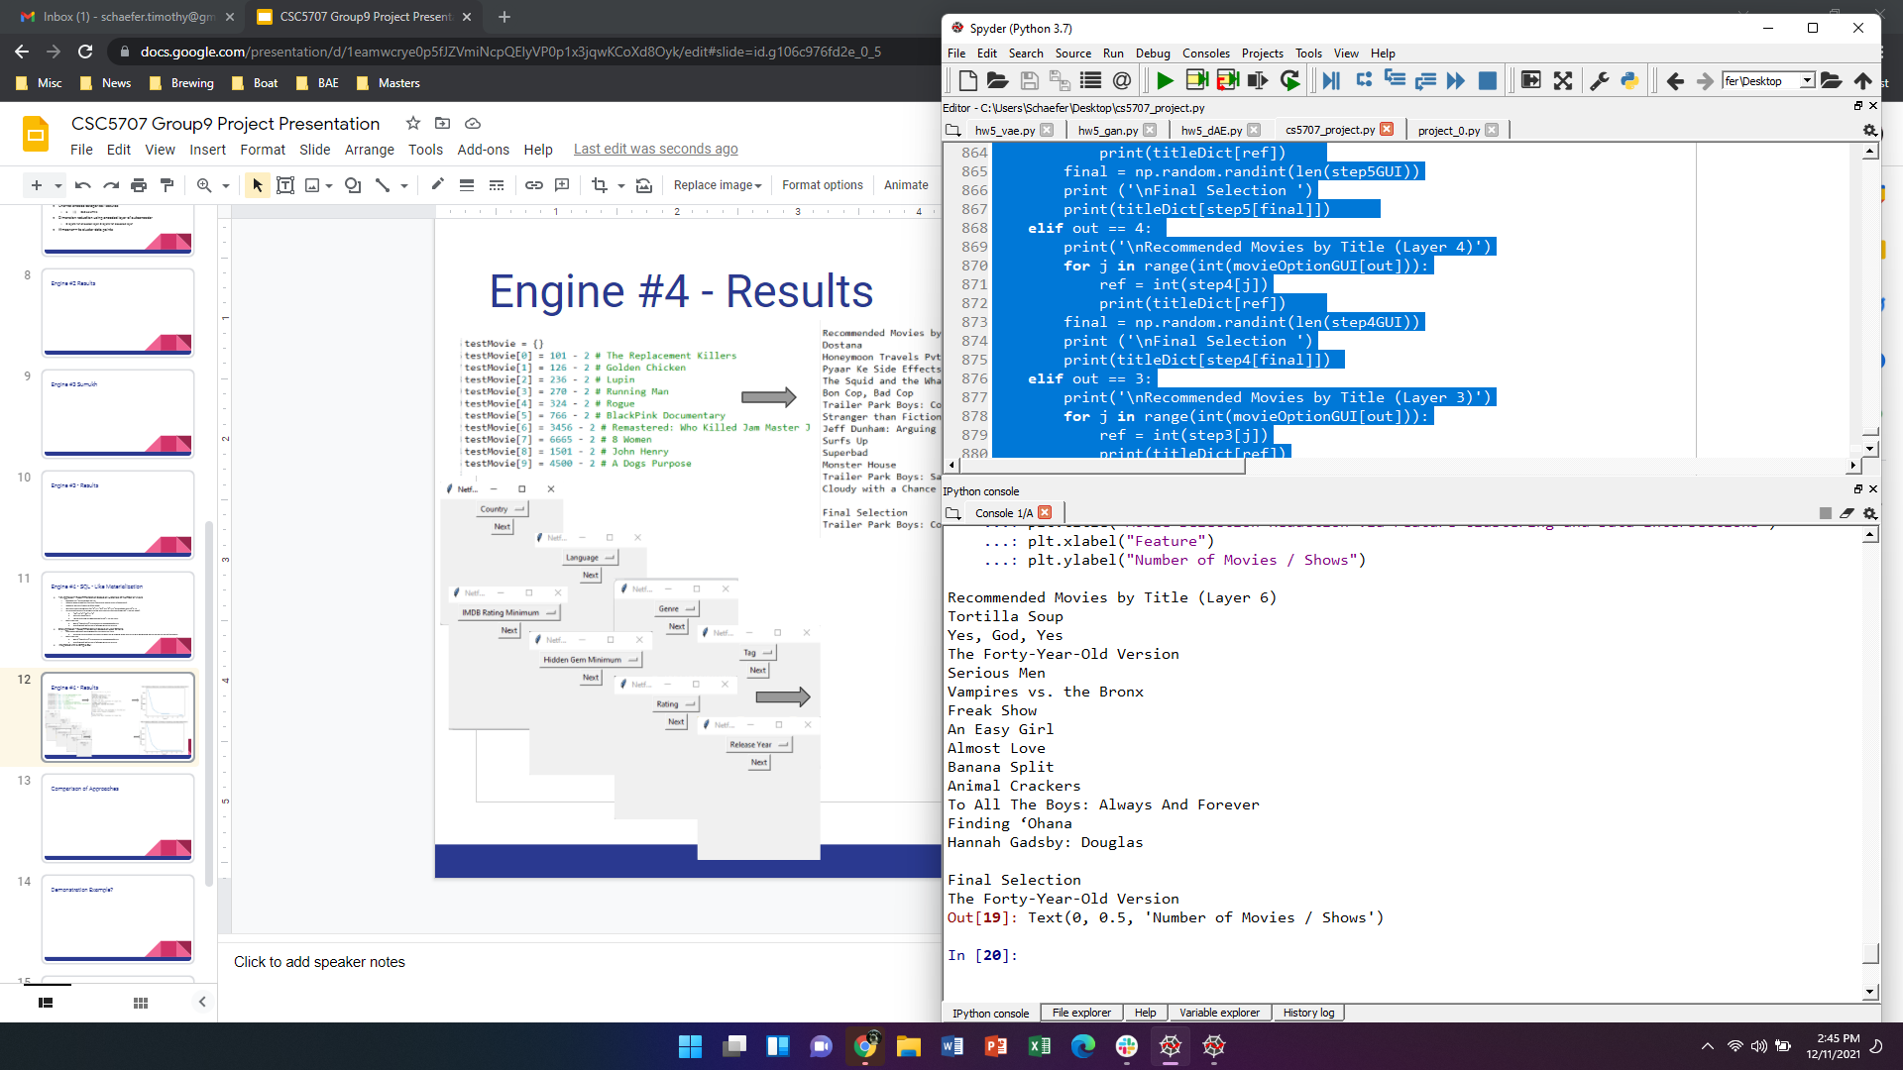

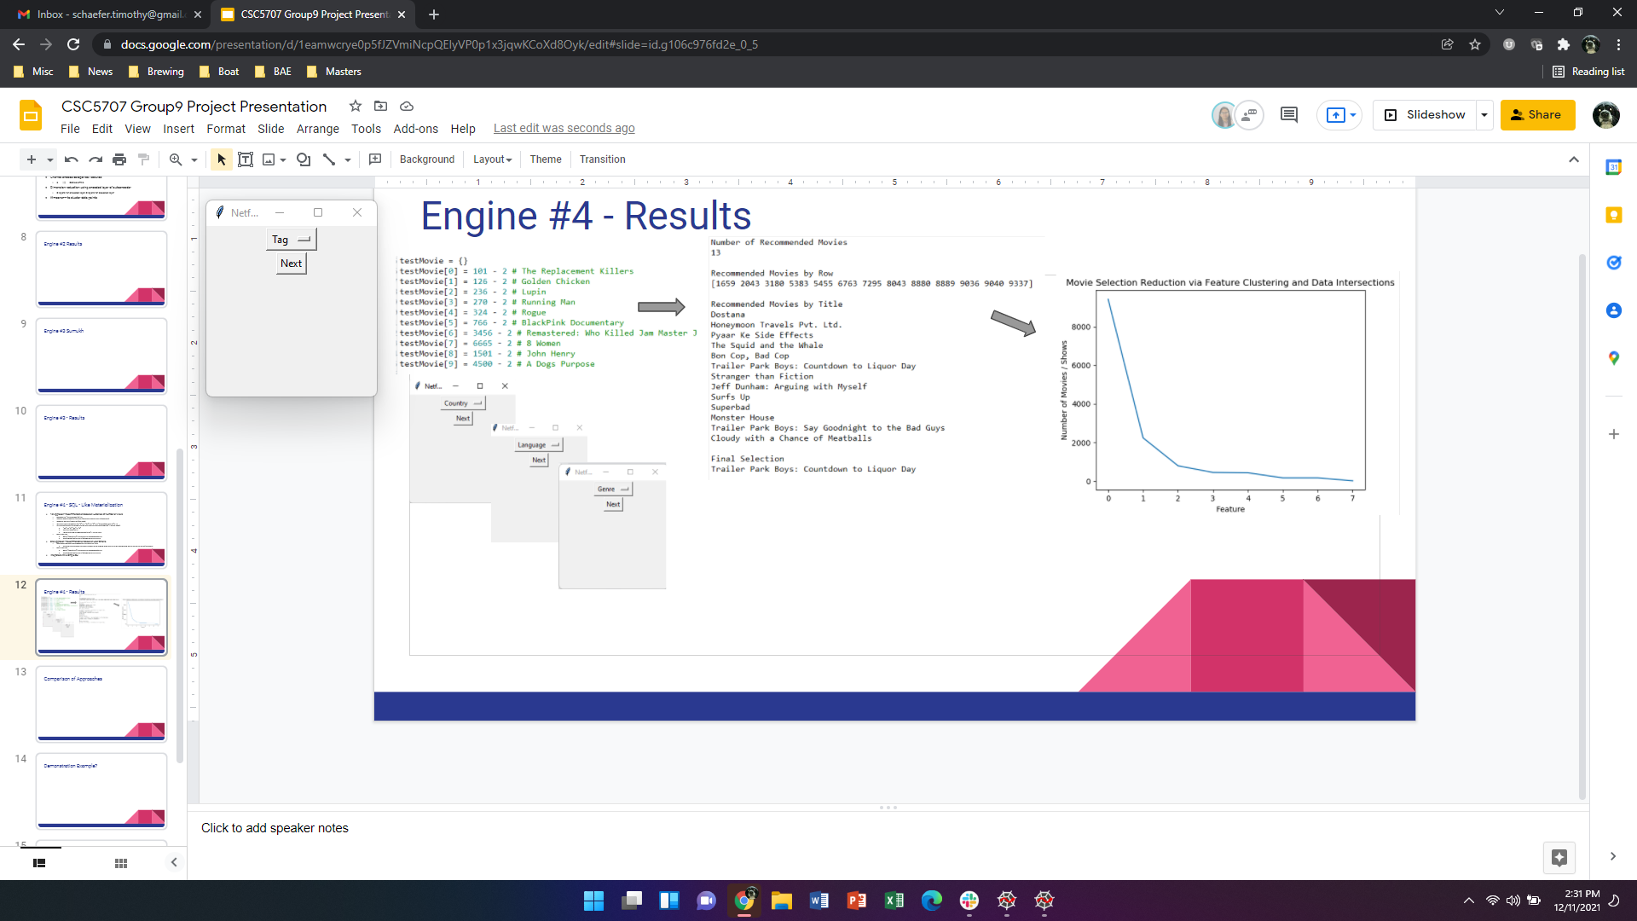
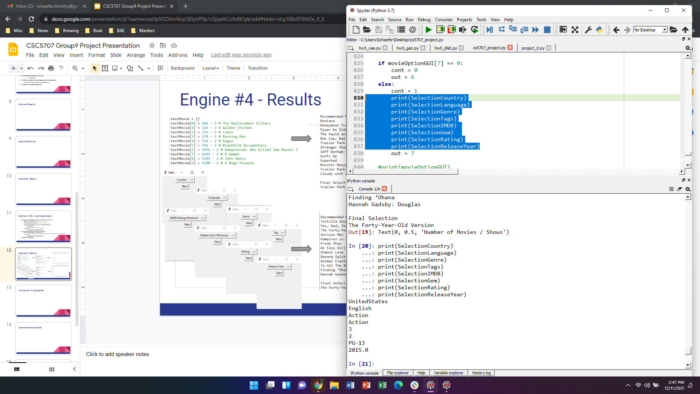
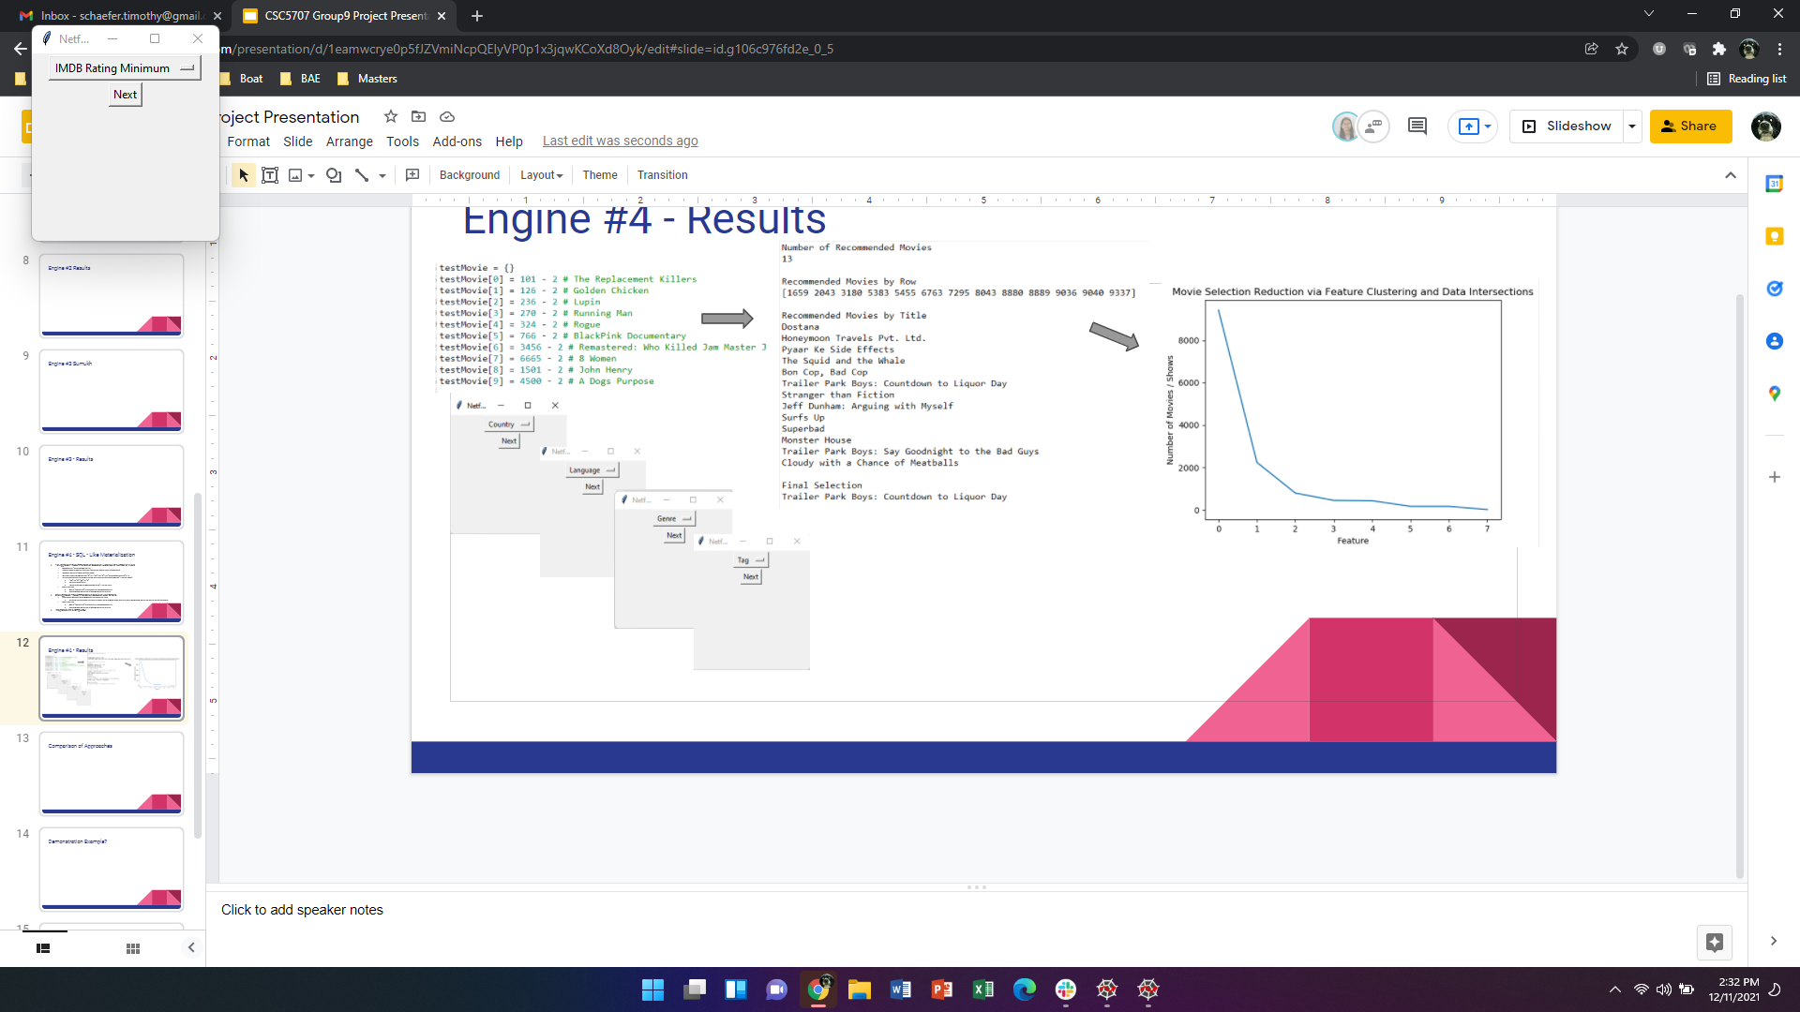
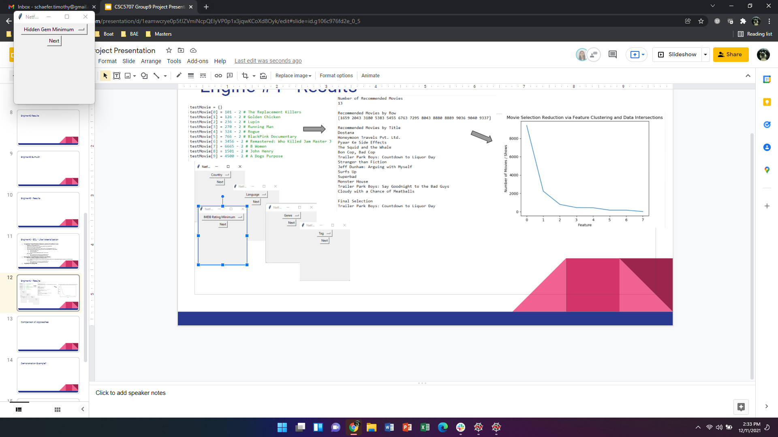
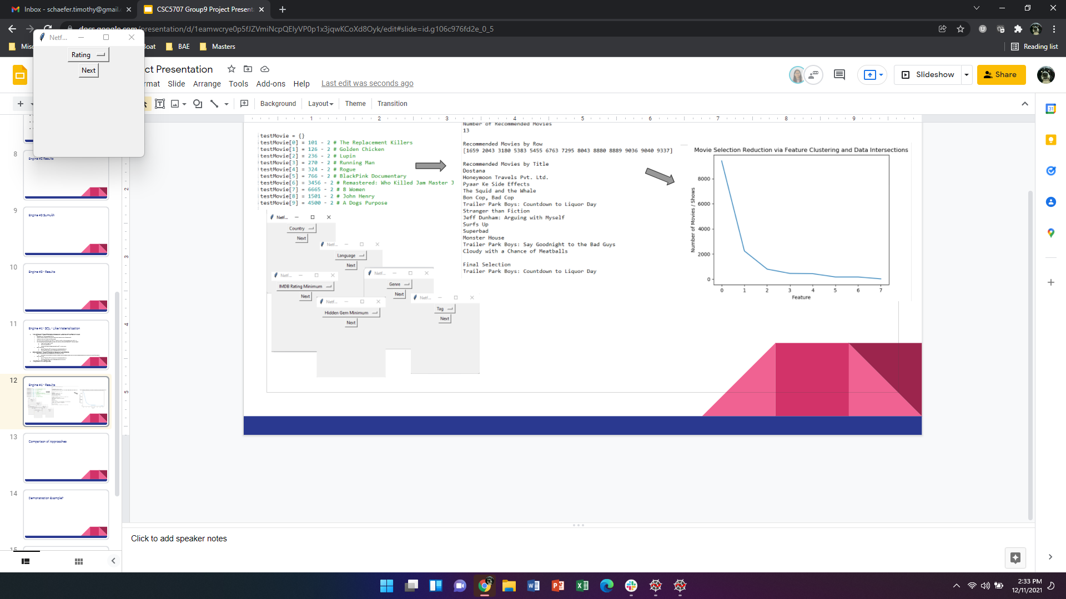
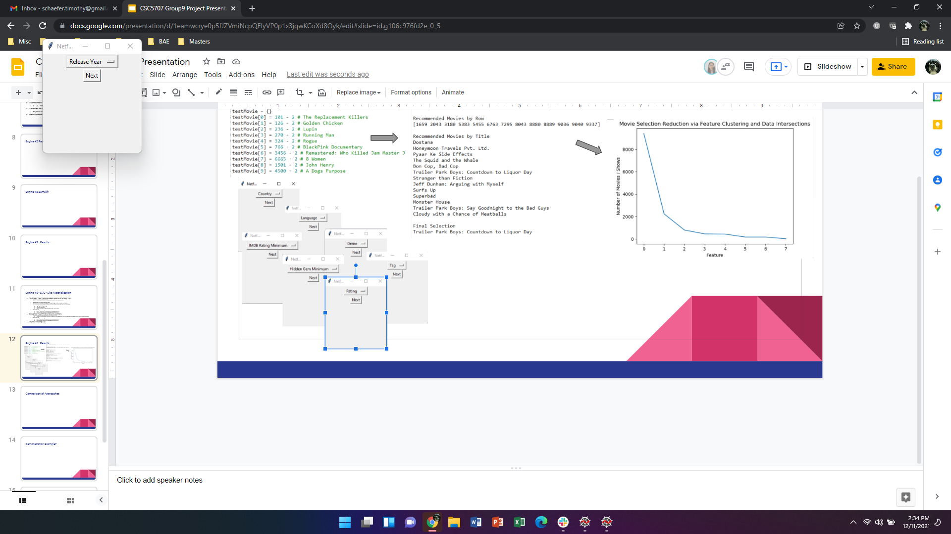
Results: Decision Tree
Historical Recommendation
User Criteria Recommendation
Notes:
Tim

Slide 13
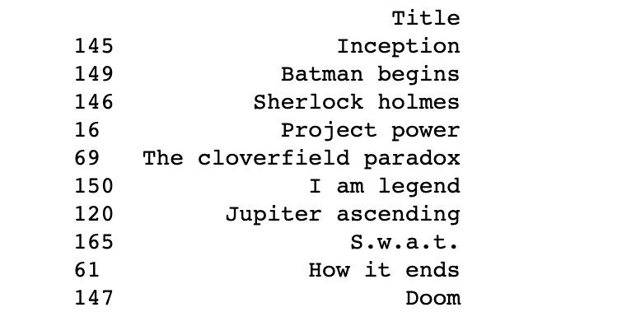
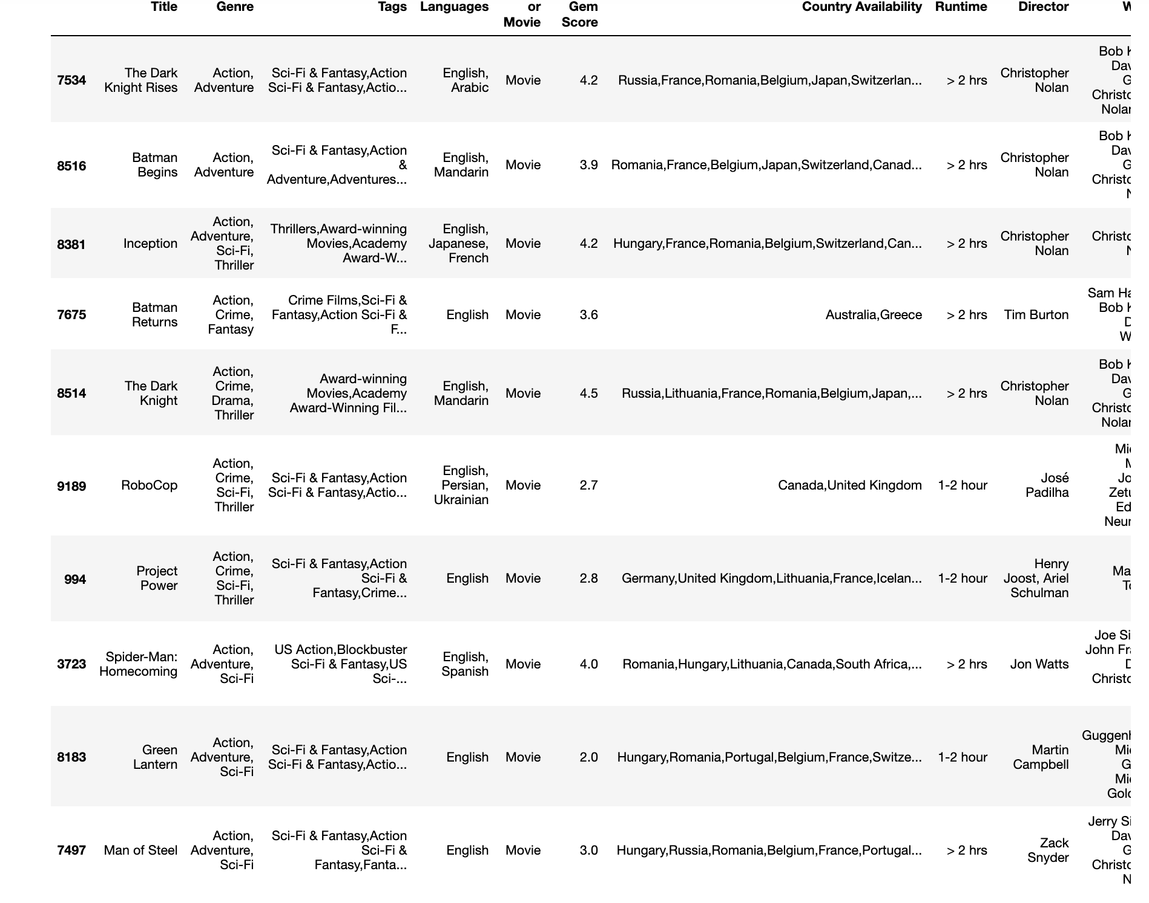
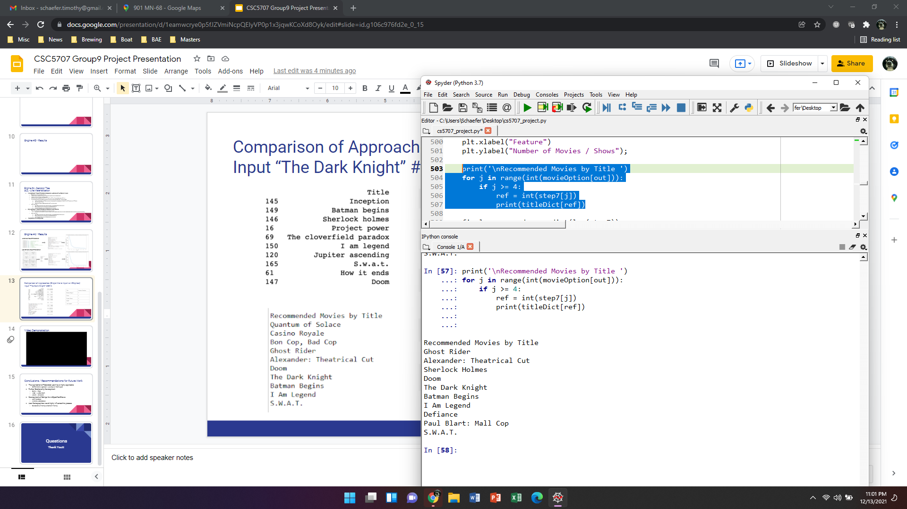
Comparison of Approaches (Single Movie Input vs 4 Engines)
Input “The Dark Knight” #8514
Title | Number Overlaps
Batman Begins | 3
Doom | 2
Project Power | 2
S.W.A.T. | 2
I am Legend | 2
Sherlock Holmes | 2
Notes:
Won

Slide 14

Video Demonstration
Notes:
Tim

Slide 15
Conclusions / Recommendations for Future Work
Federated Learning is highly applicable
Combinatorial Approach / Leverage all Techniques for best Recommendation
Improving context based understanding of the algorithm
Difference b/w nouns and verbs - ex: Good Will Hunting
Development of Ratings for UnSpecified Shows
User Feedback
Alternative Databases
User Demographics would highly influence this process
Collaborative Filtering vs Content Filtering
Notes:
Sumukh

Slide 16
Questions
Thank You!!!

